Slide 1
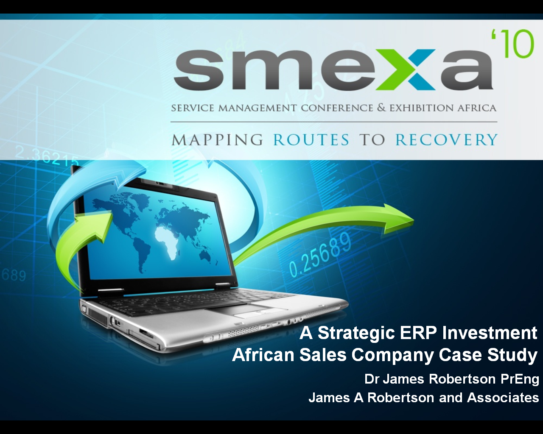
A Strategic ERP Investment
African Sales Company Case Study
Dr James Robertson PrEng
James A Robertson and Associates
Paper together with Robert Priebatsch – CEO of ASCO and major shareholder

Slide 2
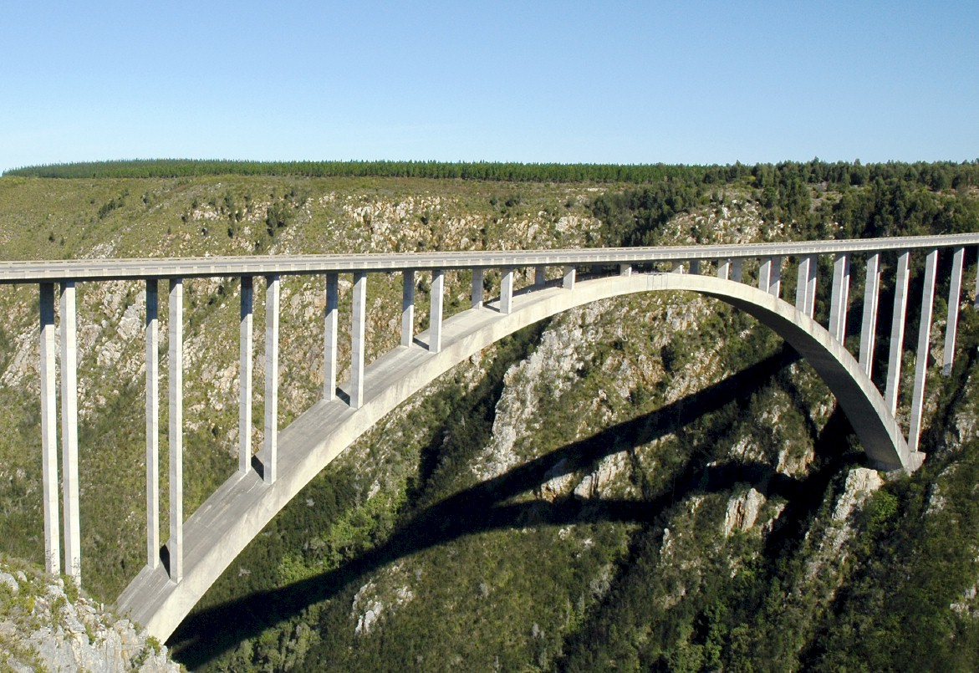
I.T. versus bridges
Notes:
In considering what i have learned as an engineer with considerable experience of the practical application of information technology i eventually realized about ten years ago that
ENGINEERS DO NOT DESIGN BRIDGES TO STAND UP – click

Slide 3
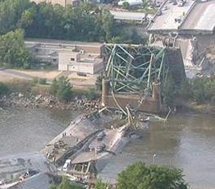
Engineers do NOT design bridges to stand up
Notes:
Who remembers this bridge collapse in Minneapolis in the middle of 2007? Within minutes it was front page news around the world – we do NOT expect bridges to fall down – if we did there would not have been anyone on that bridge that day!

Slide 4
Engineers design bridges NOT to fall down
Notes:
There is a fundamental difference in approach when one designs a bridge NOT TO FALL DOWN
Contrast this with the IT paradigm which could be called “designed to fail”

Slide 5
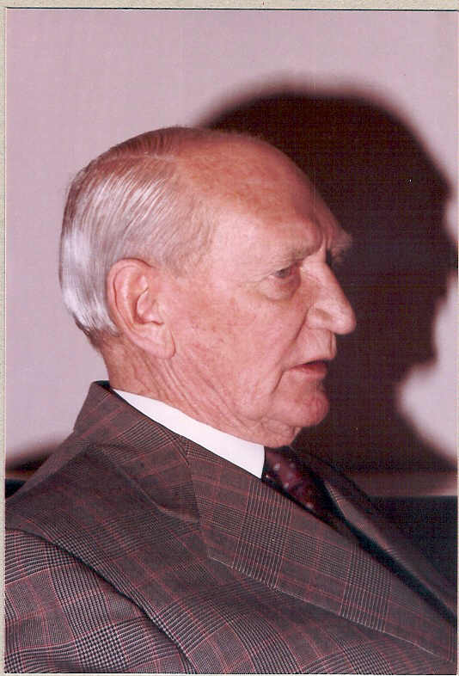
Vision
Angus Struan Robertson
Notes:
KEEP SHORT AND SIMPLE
MY FATHER
How did i get involved with computers? – my father was a visionary -- In 1981, having gathered over 7,000 pages of research data for my PhD the University mainframe did not have space to store even one page of data. My father purchased me one of the first desktop PC’s in the days of the Apple and Apricot and 123, etc – at a cost of R12,000 two and a half times my research grants! – I very quickly discovered that there was a HUGE gap between what the salesman told me the computer could do and getting it to do it – so, in that respect, NOTHING HAS CHANGED ☺ -- I then put myself through a self taught computer science programme and learned to program, learned to type and finally wrote an award winning PhD thesis – at the same time I computerized my father’s investment consulting business and we were able to double turnover in twelve months and create an enduring revenue stream that lasted for over ten years because we were able to do things that much larger businesses were not able to do – it was then that I began to understand that the strategic application of information technology COULD deliver great value and one of my greatest frustrations is the extent to which few businesses achieve this potential – the rest of this presentation is about lessons I have learned that I hope will help YOU to make a difference in your business with IT

Slide 6

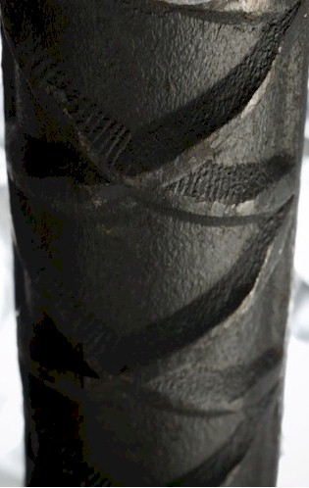


Experiencing failure

Slide 7
Information technology
Notes:
KEEP SHORT AND SIMPLE
MY FATHER
How did i get involved with computers? – my father was a visionary -- In 1981, having gathered over 7,000 pages of research data for my PhD the University mainframe did not have space to store even one page of data. My father purchased me one of the first desktop PC’s in the days of the Apple and Apricot and 123, etc – at a cost of R12,000 two and a half times my research grants! – I very quickly discovered that there was a HUGE gap between what the salesman told me the computer could do and getting it to do it – so, in that respect, NOTHING HAS CHANGED ☺ -- I then put myself through a self taught computer science programme and learned to program, learned to type and finally wrote an award winning PhD thesis – at the same time I computerized my father’s investment consulting business and we were able to double turnover in twelve months and create an enduring revenue stream that lasted for over ten years because we were able to do things that much larger businesses were not able to do – it was then that I began to understand that the strategic application of information technology COULD deliver great value and one of my greatest frustrations is the extent to which few businesses achieve this potential – the rest of this presentation is about lessons I have learned that I hope will help YOU to make a difference in your business with IT

Slide 8
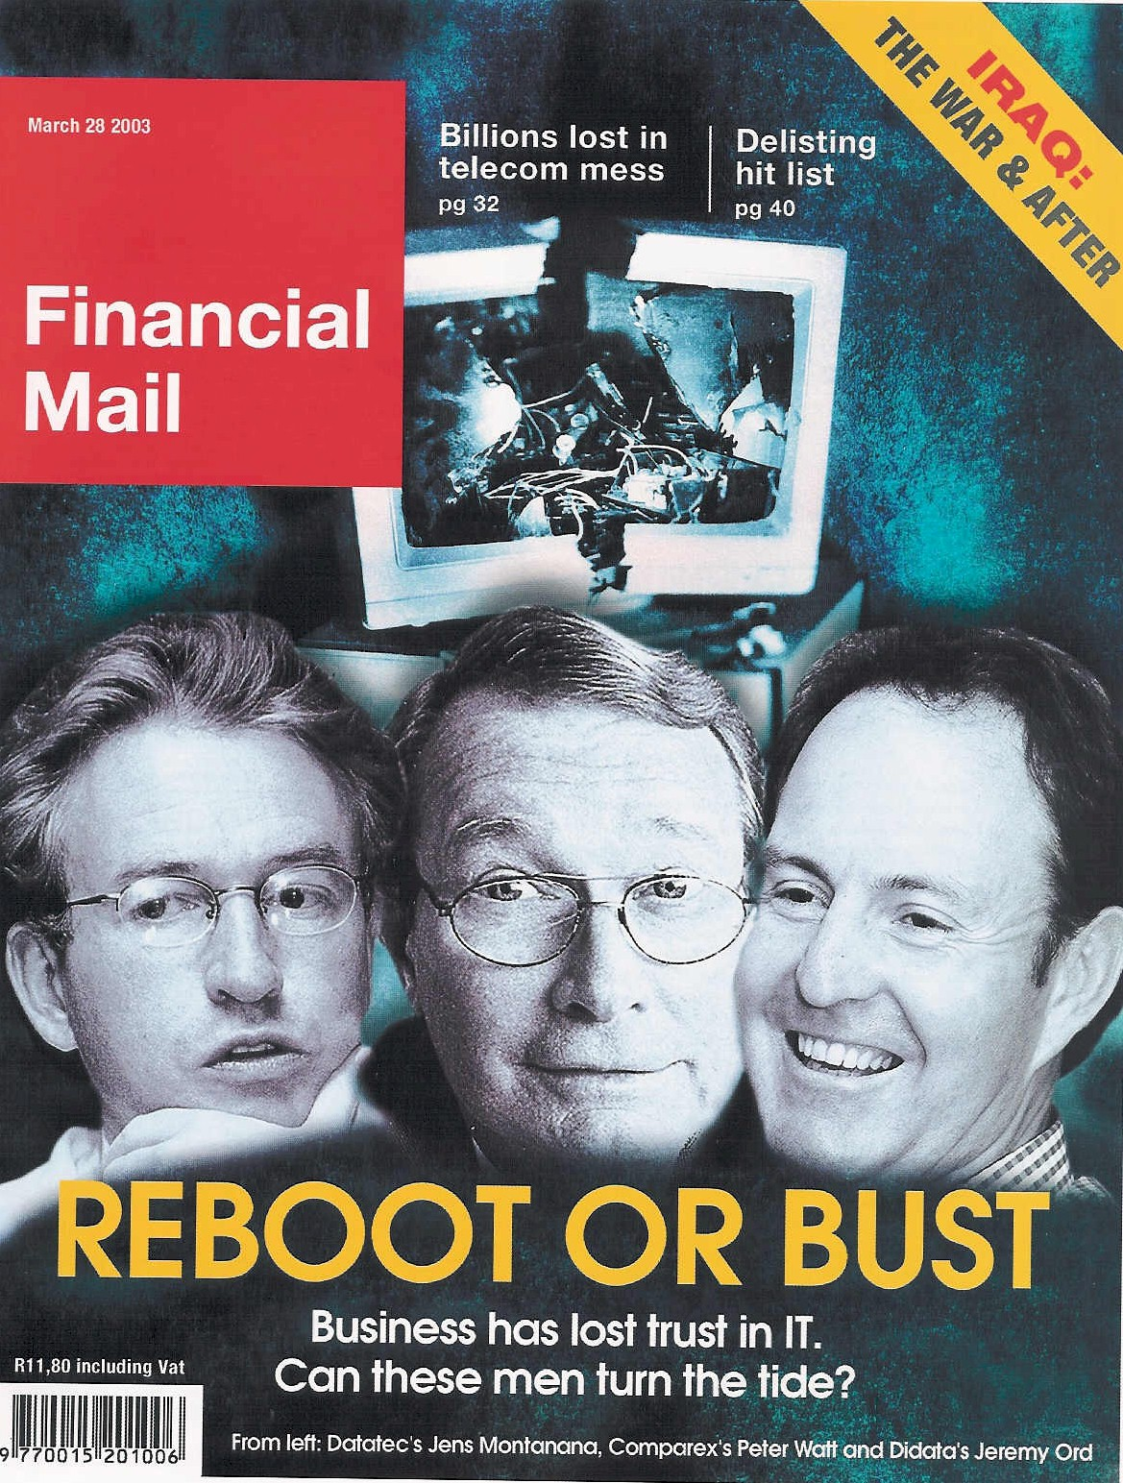

An industry in crisis
“19 out of 20 E.R.P. (business system) Implementations do NOT deliver what was promised”
Notes:
An industry in Crisis -- Quote from Duncan McLeod, Financial Mail, 28 March 2008 -- Seven years and half a billion dollars -- Dow Chemicals Company -- $400 million – Nike -- Disney -- $878 million
-- 70% of business IT projects fail outright – another 20% materially fail to meet the business expectation – 70% of BPR projects fail and 90% of strategic plans fail to deliver

Slide 9
ERP and BI failure
"Attendees of Gartner's Business Intelligence Summit in London last month were not surprised to hear that most enterprises are still failing to use business intelligence (BI) strategically. Gartner's survey of over 1300 CIOs returned some unimpressive findings about the state of BI implementations: Gartner's vice: president of research summed up the situation nicely by saying:
"Most organisations are not making better decisions than they did five years go."

Slide 10

Extreme failures
Seven years and half a billion dollars -- international chemicals company
$400 million -- multinational shoe corporation
Multinational entertainment giant -- $878 million
Major supermarket chain -- $195 million

Slide 11

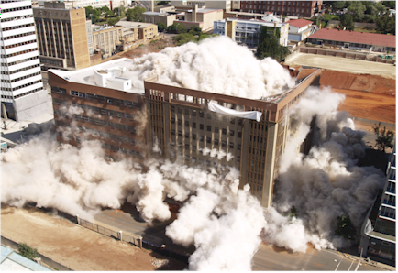
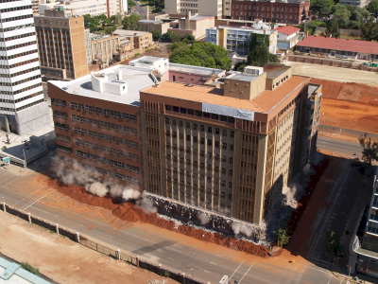
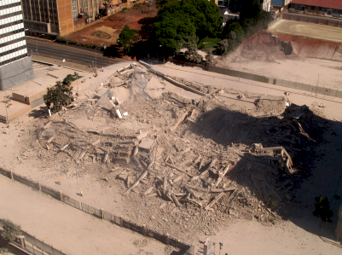
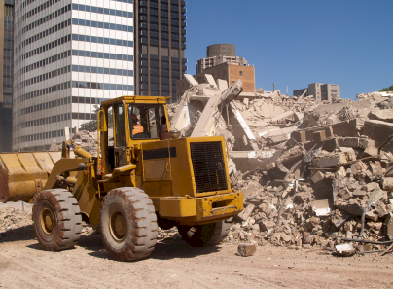
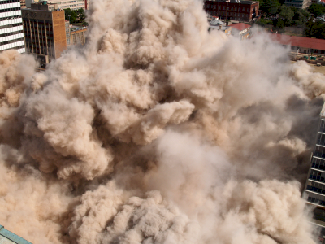

vs Deleting a building
Notes:
DHL, Prochem,

Slide 12
Business system failure can trash your business
“The next corporate disaster waiting to happen”
Professor Richard Nolan – Harvard University
Notes:
Professor Richard Nolan states that "I.T. is the next corporate disaster waiting to happen”
And postulates that soon there will be an Enron level corporate failure
Do you remember Fedsure Health – tell the story SHORT

Slide 13
There is a need for a new approach
Notes:
There is a fundamental difference in approach when one designs a bridge NOT TO FALL DOWN

Slide 14
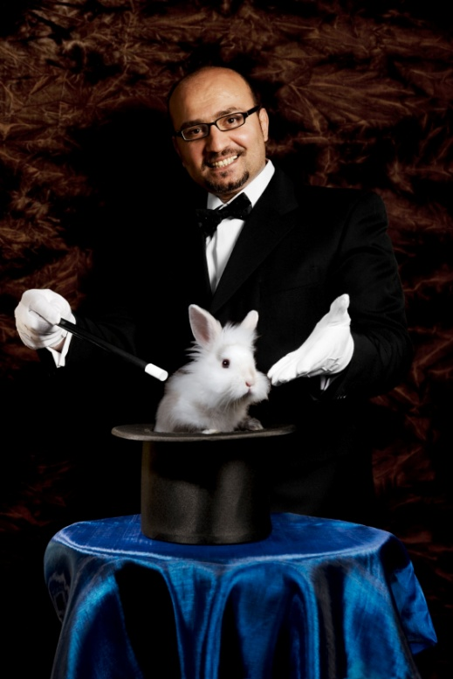

What is NOT an engineering approach?
Notes:
What is not an engineering approach? – Dramatically walk to chair – did this ever happen to you? –
WHEN SLEEPING
when i was a child i used to dream that i would stand on a chair and flap my arms and fly around the room --i have to say that that is NOT an engineering approach – as much as i may be convinced i can fly i have to say to you that were i to stand on top of a skyscraper and flap my arms and jump i would hit the ground at great speed and almost certainly die – that is NOT an engineering approach and yet many seem to think they can use software to do things magically – many are hypnotized and mesmerized by IT – are you? CLICK for rabbit out of the hat

Slide 15
Notes:
WHAT CAUSES IT FAILURE?
Since 1993, analysed in 2003, course, book
Sustainable versus experimentation
People
The factors causing IT failure – in 1993 I became aware of the high failure rate of IT projects and started to talk about it – as a consequence i was asked to investigate many failed or failing projects and to help to turn them around – over the years i built up a large catalogue of the factors causing failure – in 2003 i undertook a critical issues analysis of the factors causing failure and arrived at a list of seven critical factors causing failure together with the critical factors for success which then became the subject of a course and subsequently a book – HOLD UP THE BOOK – since then i have advised many clients and led a number of significant projects and consistently validated the basic analysis
The biggest single factor causing failure is Mythology at 30% followed by lack of executive custody and inappropriate governance at 25%

Slide 16
Factors causing IT failure
Notes:
NB People
KEEP IT SHORT

Slide 17

The value of technology is determined by the person using the technology
Notes:
A gun is neither good nor bad
If it is held by a person you regard as good and pointed at a person you regard as bad the gun is good
BUT if it is pointed at YOU it is always BAD!

Slide 18

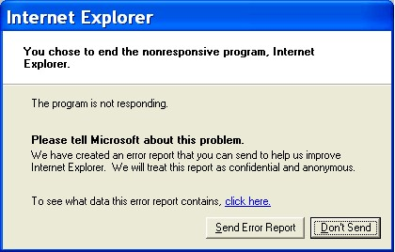
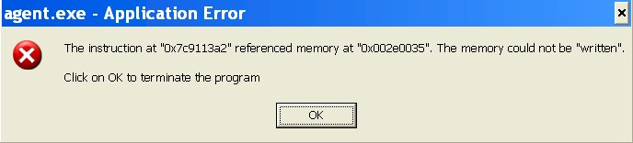
Technology is only 5% of what causes failure
Software defects CAN be prevented
Take a stand
Notes:
A gun is neither good nor bad
If it is held by a person you regard as good and pointed at a person you regard as bad the gun is good
BUT if it is pointed at YOU it is always BAD!

Slide 19
Implementation scenarios
10
The Opportunity
Real Potential of ERP & …
Where many are
Where the industry is
Where the technology can go
Where you can go
High quality design gives high quality outcomes at much lower overall lifetime operating cost
10
Common View of “Best” Practice
10
4
2
1
0
0
0
Notes:
DHL, Prochem,

Slide 20
African Sales Company (ASCO)
Distributing and marketing fragrances
Service excellence
Supplies major retailers
Represents major European fragrance manufacturers
Receipt in bulk, issue in singles to tight delivery windows
40% of turnover between October and mid-December
Strong relationships
Brand managers
Ageing system and ageing developer – “we had no option but to change”

Slide 21
The ASCO ERP Project
Between Syspro and SAP Business One
Opted for Syspro
Third party Warehouse Management System bolt on
WMS been replaced recently
Implementation commenced January 2007
Stalled
James Robertson brought in in October 2007 to do Pulse Measurement and then took on role of Project Leader to bring to live operation end of March 2008
Some major benefits and some costly and traumatic failures

Slide 22
The ASCO ERP Project
Strong engineering focus
Rigour
Laboratory testing but NOT all elements were tested due to time and budget constraints
Precision strategic configuration (data engineering)
Considerable emphasis on modelling the brand hierarchy in the Product Class and other attribute tables as well as the Chart of Accounts
Robert sums up the project as follows “the project required interesting logic, it was a compelling project, there was much to learn, and in time we will look back and say ‘it was a worthwhile experience, despite the stressful additional work load imposed under frustrating time deadlines’”

Slide 23
Greatest benefits
Downturn in the economy masked flaws and benefits
Major benefit was modelling of full “Advertising and Promotions” budget across numerous brand lines and expense headings using Syspro’s “Projects and Contracts” module accompanied by limited custom development
Accomplished through highly structured Product Class brand hierarchy taxonomy and a number of other custom taxonomies.
Brand costs are captured seamlessly from various sources.
An innovative use of the Projects and Contracts module
Also highly structured capture of product data

Slide 24
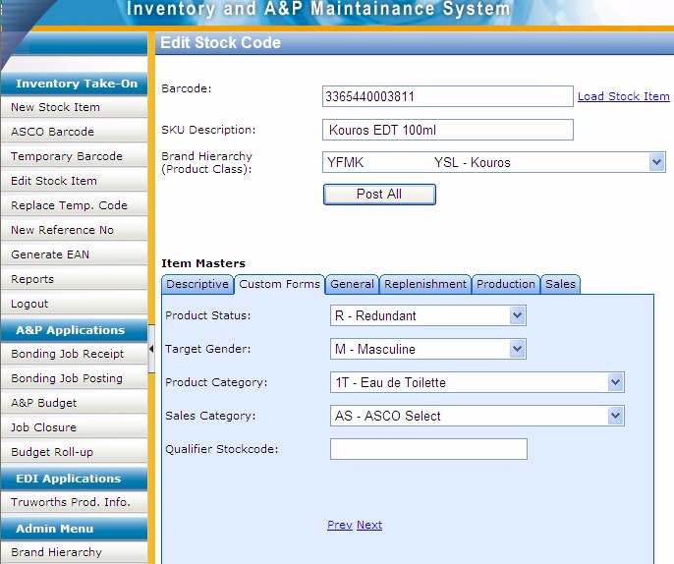
Custom data entry screen with custom taxonomies
Notes:
DHL, Prochem,

Slide 25
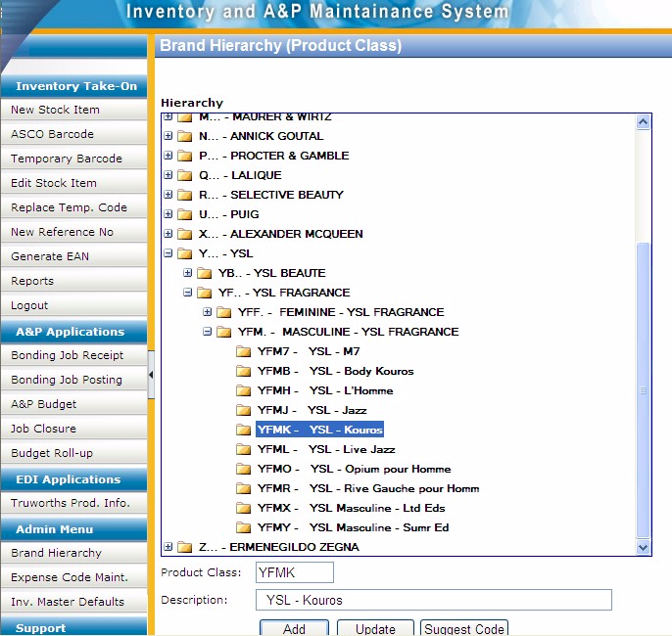
Custom code maintenance development for client specific taxonomy
Notes:
DHL, Prochem,

Slide 26
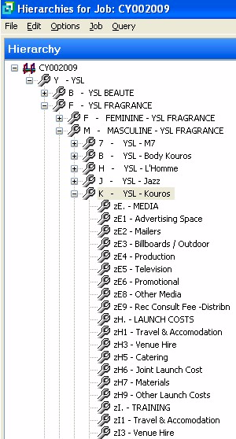
Matching codes in unrelated modules provide logical integration
Getting the software to do what it supposedly cannot do
Notes:
DHL, Prochem,

Slide 27
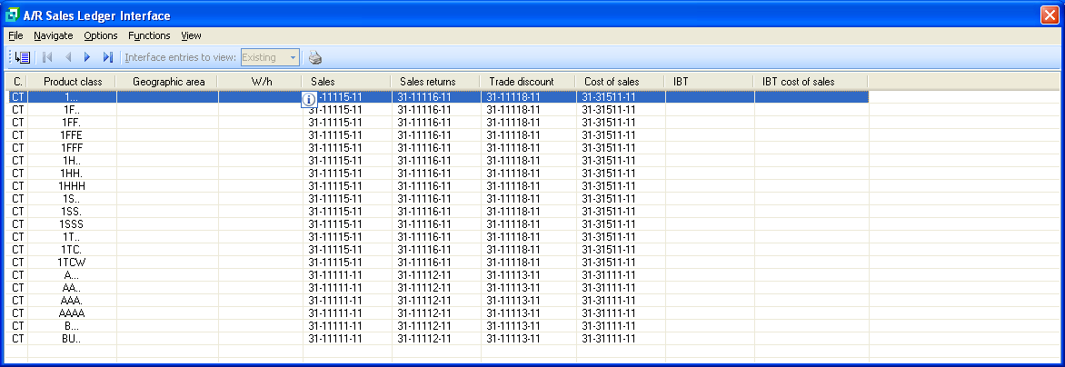
Uniform integration pattern
Notes:
DHL, Prochem,

Slide 28
Expensive lessons
Failing to rigorously test the third party Warehouse Management System in a laboratory environment – fell over in a nearly catastrophic fashion after we went live and subsequently a problem with short shipments
Failing to rigorously test the third party Electronic Data Interchange module – also fell over in a nearly catastrophic fashion after go live
  Two retailers took three months to get working correctly
  In one case retailer was unable to receipt goods
  Largest retailer payments were rejected for ninety days
Robert says “In our business, if you cannot transact electronically with your customers you do not have a business and we were close to this for several weeks. Rigorous testing would have prevented this entirely.”

Slide 29
Expensive lessons
Core Syspro installation set up a laboratory and simulated most aspects of operations before go-live.
Now know the testing was not as rigorous as it should have been
The downturn in the economy masked the short shipments but “if the economy had been booming the software errors could have crippled us”
We did not test rigorously because of time and budget constraints
Also economized on time implementing the General Ledger Chart of Accounts and particularly on the GL integration with the result that financials were not reliable, there was difficulty auditing and in obtaining reliable financial reports
Robert – the biggest mistake was a lack of rigour -- “everything you pass up you WILL regret”.

Slide 30
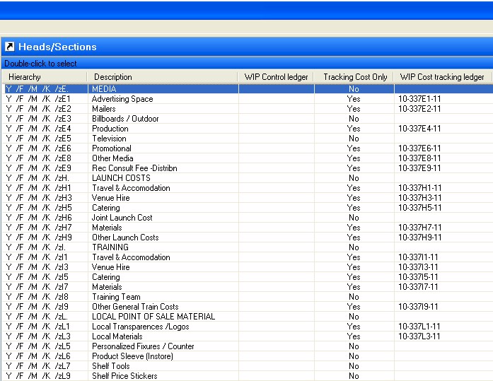
GL integration problems
Notes:
DHL, Prochem,

Slide 31
Things we did right – client view
“The Highly structured product taxonomy product class linking to Projects and Contracts for Advertising and Promotion has given us a powerful strategic resource for conducting our brand management activities and has put us in position to give excellent financial reporting to our suppliers.”
“Rigour in most of our classifications (taxonomies) has given us exceptional flexibility and ease of analysis and reporting in many areas. Areas where we did not apply this rigour, such as in debtors, are now a source of regret.”
“Small things like rigour and discipline with regard to data capture standards, capitalization, spelling, etc. From the start we stressed high quality data and that is what we have, our invoices are neat and presentable and our reports do not require cosmetic surgery.”
“Replacing the warehouse management system at this stage appears to be a great win.”

Slide 32
Things we did right – client view
“We have developed a disciplined culture in which we do not take short cuts. People understand the impact of their actions on other parts of the business”

Slide 33
Things we did right – Project Leader view
Degree of executive custody
High engagement by the CEO
Taxonomies are a major factor
Laboratory
Strategic focus – the essence of the business
Top down approach

Slide 34
What I would do differently -- CEO
MORE RIGOUR – “everything you bypass you will regret”
Research and test all third party products thoroughly
Comprehensive and rigorous laboratory testing using real data
Greater rigour with regard to operational processes
Comprehensive taxonomies on ALL modules including Debtors and Creditors
Much more effort into reporting and analytics
  We are now appointing a senior analyst to do this
  We have a mountain of information we are not using to full potential

Slide 35
What I would do differently – Project Leader
Advocate comprehensive laboratory testing much more strongly
Higher level of involvement in all the areas where we economized on my time
Stay engaged for the first year after go-live
Guide the realization of the full potential of the taxonomies in the analytics
Ensure comprehensive auditing of the installation before go-live – no mispostings and no missing configuration entries

Slide 36
Would we do it again?
“YES, in time we will look back and say that was worthwhile and career enhancing” (Robert)
“Yes, barring some rough patches it was one of the most positive project experiences of my career, the level of CEO involvement was a highlight of my career” (James)

Slide 37

If you do not act within 48 hours you probably never will – act TODAY! ☺
James@JamesARobertson.com
Telephone: ++27-(0)83-251-6644

Slide 38

Design your IT solutions like bridges ...
NOT to fall down!

Slide 39
